Slide 1

Supervised ML - Classification Capstone Project
Health Insurance Cross Sell Prediction

Slide 2
Introduction
Introduction
“Time and health are two precious assets that we don’t recognize and appreciate until they have been depleted.” Denis Waitley
Insurance is a way of managing risks. When we buy insurance, a insurance company undertakes to provide a guarantee of compensation for specified loss, damage, illness, or death in return for the payment of a specified premium. A premium is a sum of money that the customer needs to pay regularly to an insurance company for this guarantee.
Insurance sector in India plays a dynamic role in the wellbeing of its economy. It substantially increases the opportunities for savings amongst the individuals, safeguards their future and helps the insurance sector form a massive pool of funds.
Our client is an Insurance company that has provided Health Insurance to its customers now they need our help in building a model to predict whether the policyholders (customers) from past year will also be interested in Vehicle Insurance provided by the company.

Slide 3
Attributes
id : Unique ID for the customer
Gender : Gender of the customer
Age : Age of the customer
Driving License 0 : Customer does not have DL, 1 : Customer already has DL
Region Code : Unique code for the region of the customer
Previously Insured : 1 : Customer already has Vehicle Insurance, 0 : Customer doesn't have Vehicle Insurance
Vehicle Age : Age of the Vehicle
Vehicle Damage : Yes : Customer got his/her vehicle damaged in the past. No : Customer didn't get his/her vehicle damaged in the past.
Annual Premium : The amount customer needs to pay as premium in the year
Policy Sales Channel : Anonymized Code for the channel of outreaching to the customer i.e. Different Agents, Over Mail, Over Phone, In Person, etc.
Vintage : Number of Days, Customer has been associated with the company
Response : 1 : Customer is interested, 0 : Customer is not interested
Our data set contains 381109 rows and 12 columns.

Slide 4
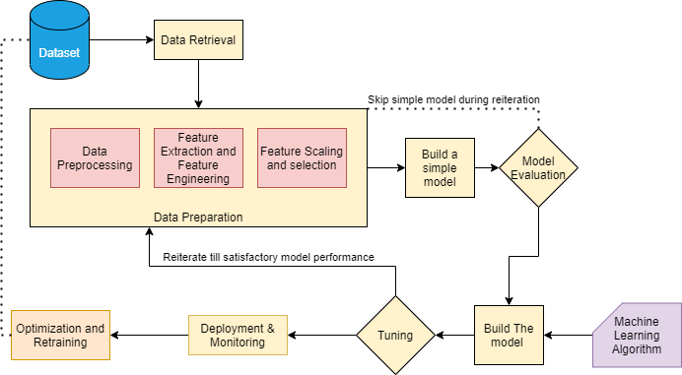
Workflow

Slide 5
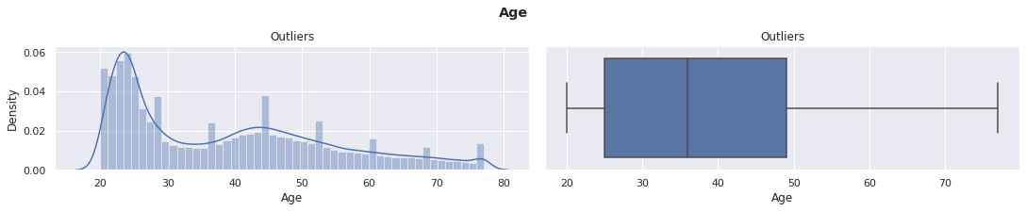
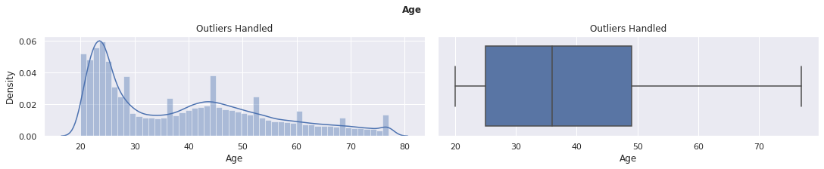
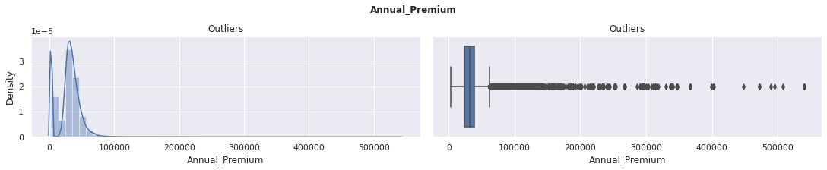
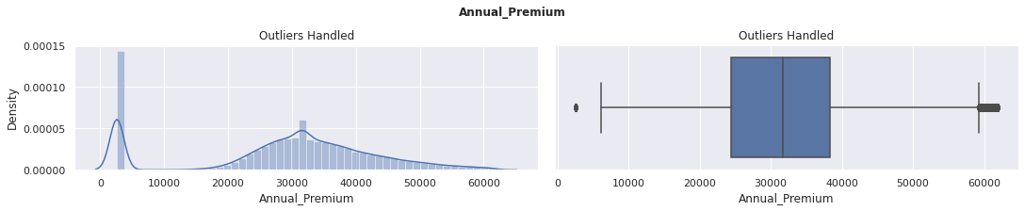
Handling Outliers

Slide 6
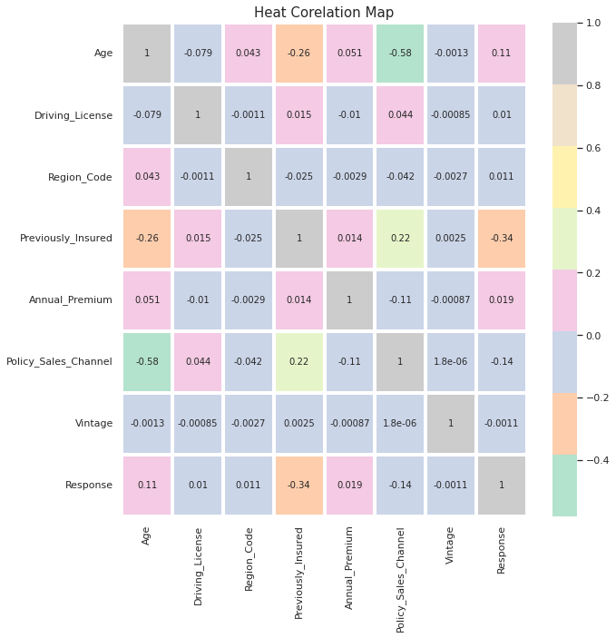
Correlation

Slide 7
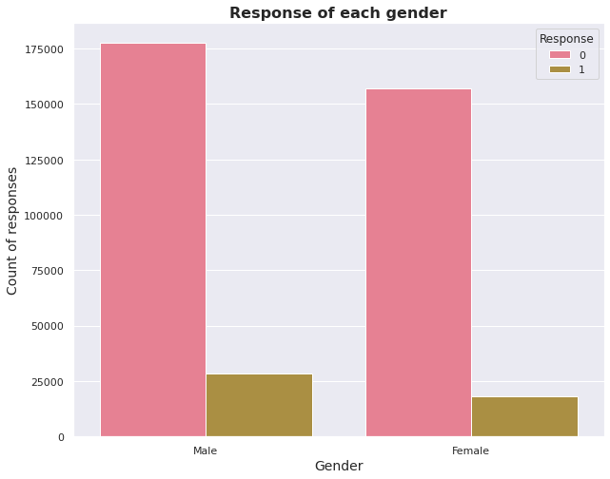
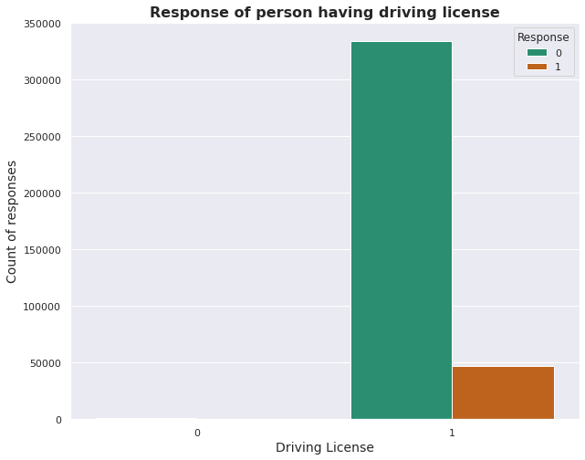
Gender
Driving License
Males are more interested in taking Insurance as compared to Females.
Persons having driving license are more likely to take Insurance.

Slide 8
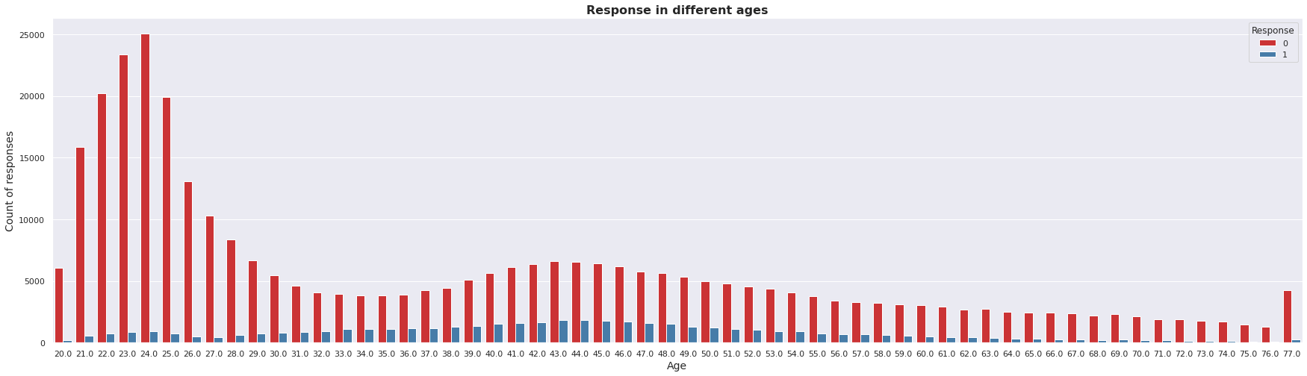
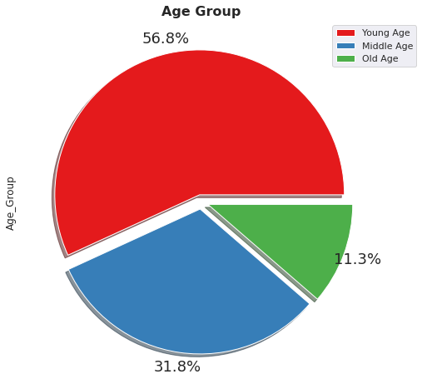
Age Vs Response
Most of the people lies in Young Age population(20-30 yrs) but chances of taking Insurance is more in Middle Age Population(30-50 yrs).

Slide 9
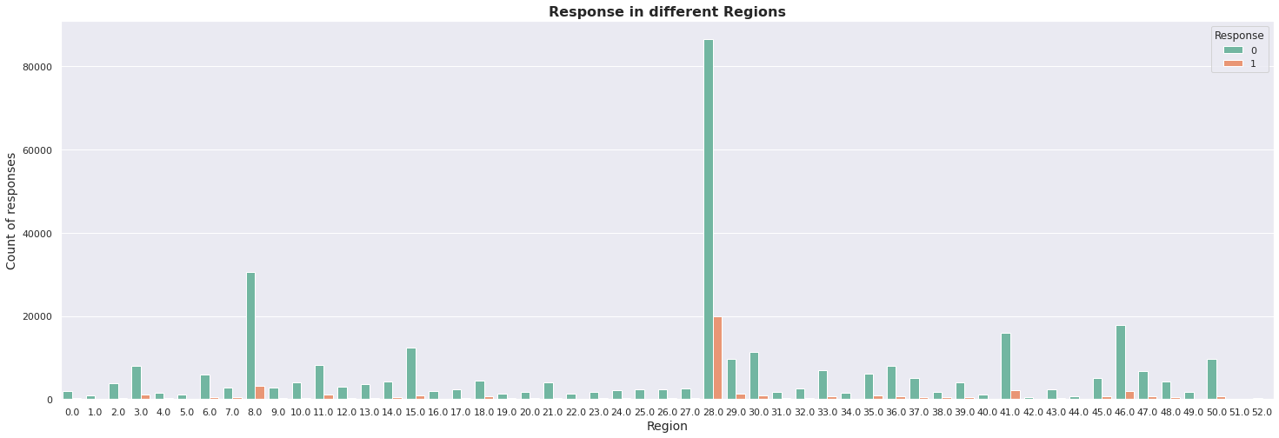
Region Vs Response
Region-28 shows the highest number of persons taking the Insurance amongst all Region Code.

Slide 10
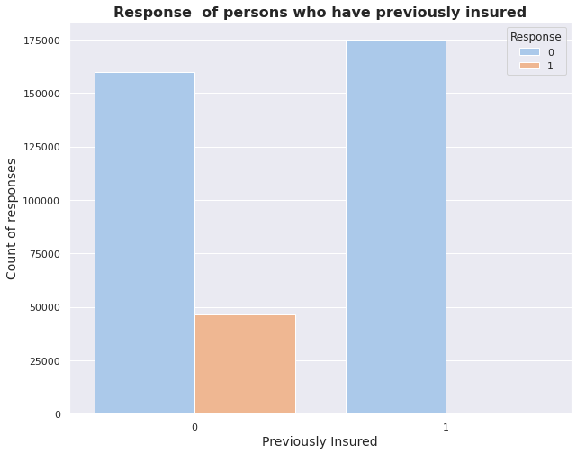
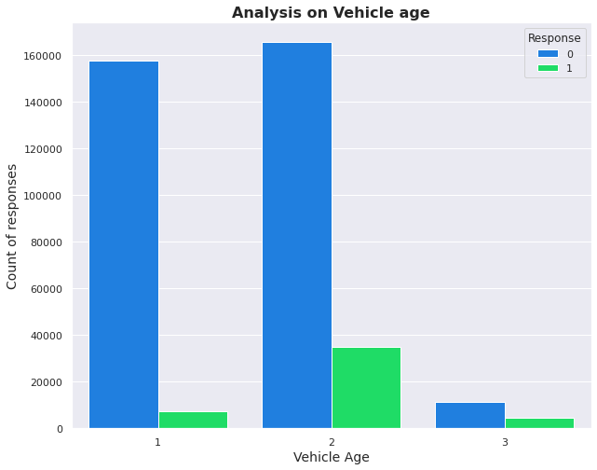
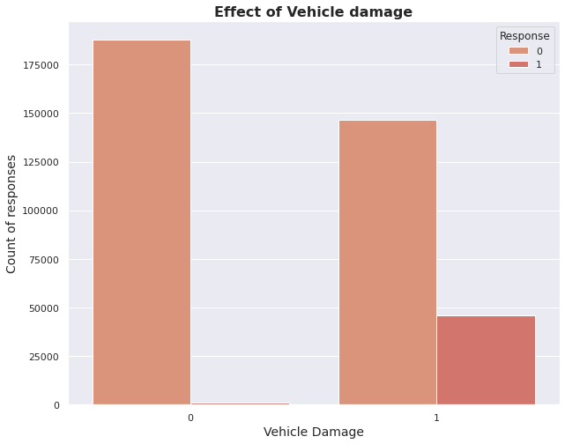
Previously Insured
Vehicle age
Vehicle Damage
Persons who are not previously insured are more likely to take Vehicle Insurance.
Persons whose vehicle age is between 1-2 yrs are most interested in taking Vehicle Insurance.
People who have faced vehicle damage is more likely to take Vehicle Insurance.

Slide 11
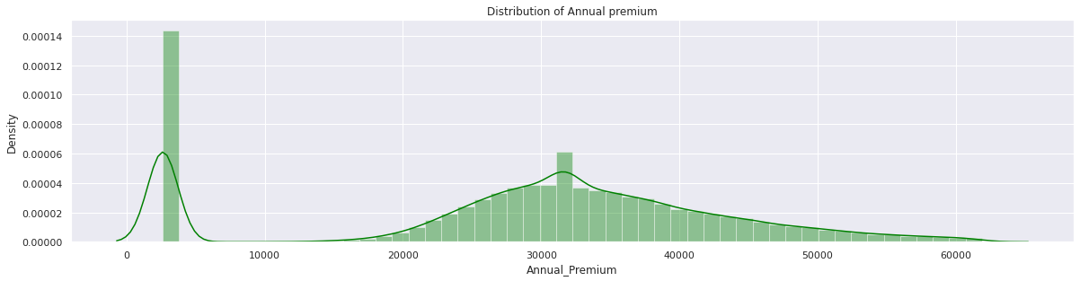
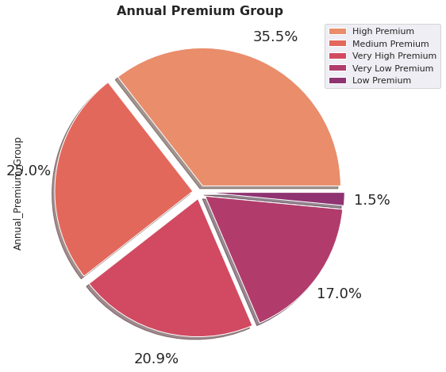
Annual Premium
Majority of Annual Premium lies in High Premium(30k-40k)

Slide 12
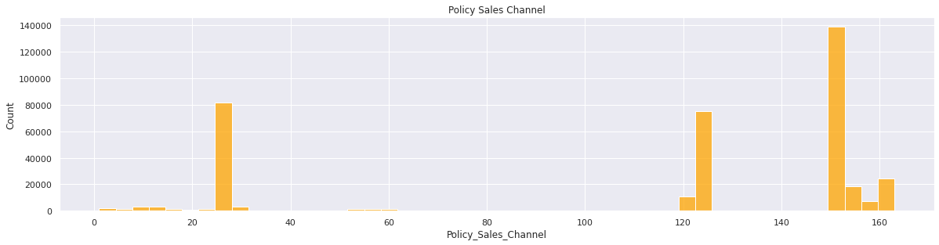
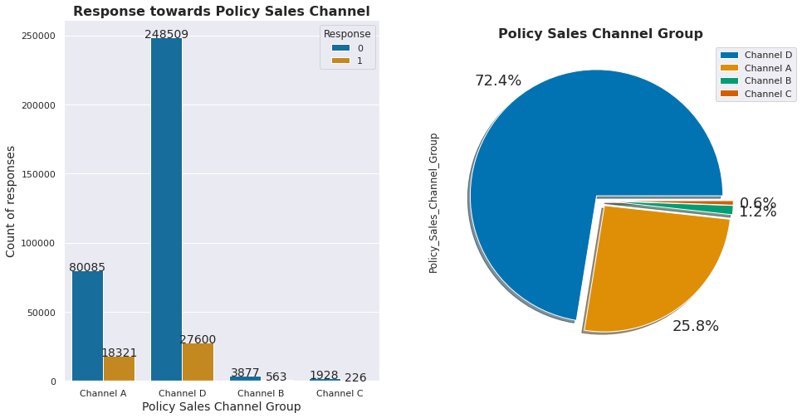
Policy Sales Channel
Sales Channel D(140-160) is the most contacted channel among all the channels and it has provided highest no. of conversion.

Slide 13
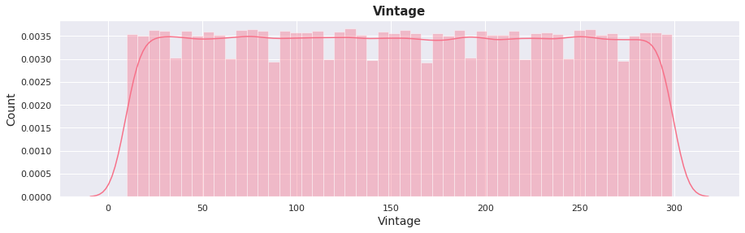
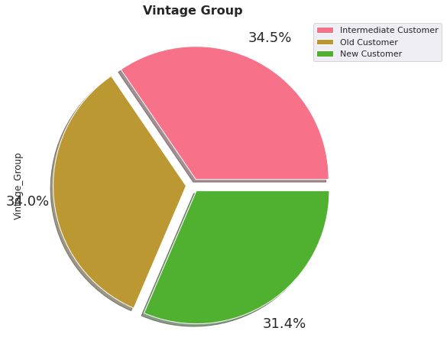
Vintage Vs Response
Vintage for customers lies from 10 days to 300 days and there is nearly equal distribution for each type of customers.

Slide 14
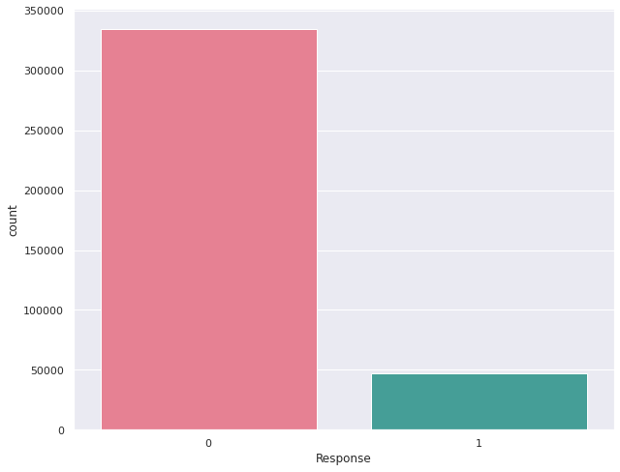
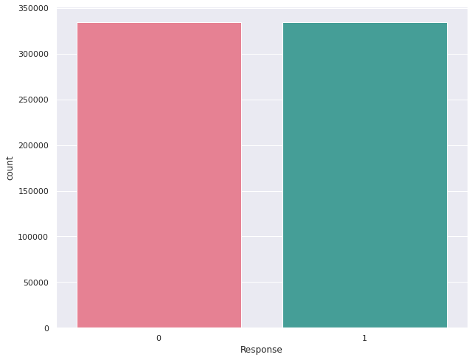
Handling Imbalance Dataset
Since our dataset was highly imbalanced we have used ‘SMOTE’ process to treat it.
SMOTE- SMOTE is an oversampling technique where the synthetic samples are generated for the minority class to solve the imbalance problem.

Slide 15
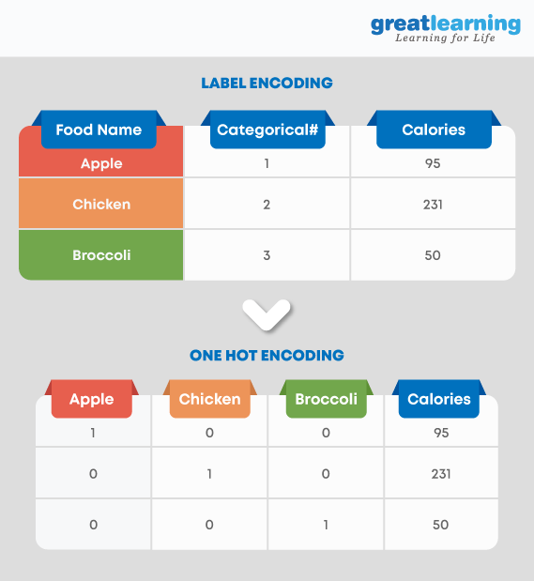
Feature Encoding
Label Encoding
Label Encoding refers to converting the labels into a numeric form so as to convert them into the machine-readable form.
One Hot Encoding
One-hot encoding converts the categorical data into numeric data by splitting the column into multiple columns.

Slide 16
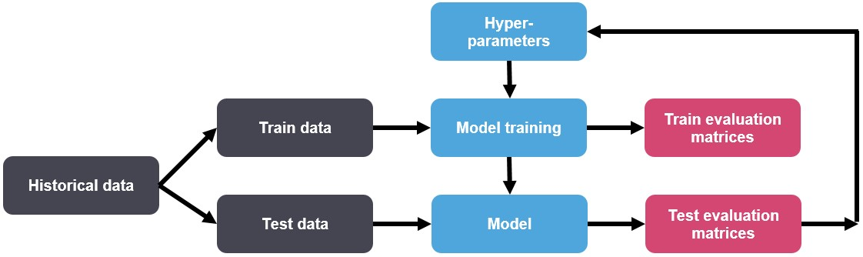
Train Test Split & Hyperparameter Tuning
Train-Test split- We have splitted our dataset into Train and Test data in the ratio of 80:20.
Hyperparameter Tuning- We have used Halving Random Search cv and Random Search cv for hyperparameter Tuning

Slide 17
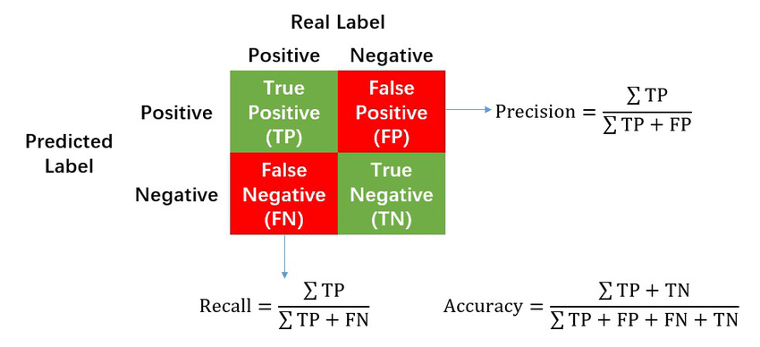
Metric Comparison Features
Precision- Precision quantifies the number of positive class predictions that actually belong to the positive class. Precision is calculated as the ratio between the number of Positive samples correctly classified to the total number of samples.
Recall- Recall quantifies the number of positive class predictions made out of all positive examples in the dataset. The recall is calculated as the ratio between the number of Positive samples correctly classified as Positive to the total number of Positive samples.
Accuracy- Accuracy measures the number of correct predictions made by a model in relation to the total number of predictions. It can be calculated by dividing the number of correct predictions by the number of total predictions.

Slide 18
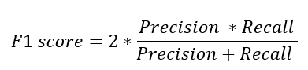
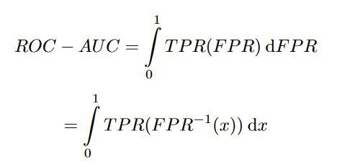
Metric Comparison Features
F1 Score- The F1-score combines the precision and recall of a classifier into a single metric by taking their harmonic mean. It is primarily used to compare the performance of two classifiers.
ROC-AUC Score- ROC-AUC Score(Receiver Operating Characteristics-Area Under Curve) help determine the exact trade-off between the true positive rate(TPR) and false-positive rate(FPR) for a model using different measures of probability thresholds.

Slide 19
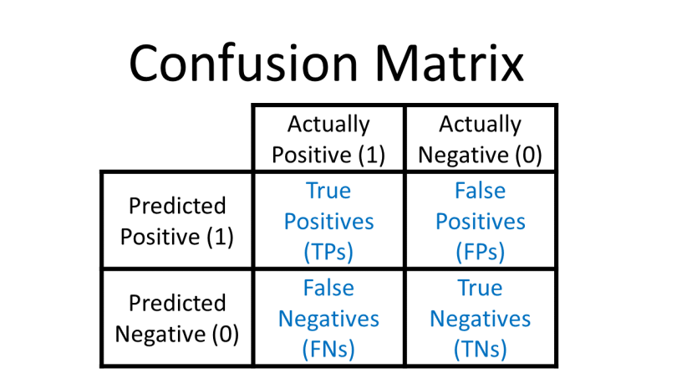
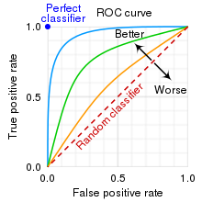
Performance Metrics Visualization
Confusion Matrix- Confusion matrix is a table that is used to describe the performance of a classification model on a set of test data for which the true values are known. A confusion matrix is a tabular summary of the number of correct and incorrect predictions made by a classifier.
ROC-AUC Curve- AUC stands for "Area under the ROC Curve." That is, AUC measures the entire two-dimensional area underneath the entire ROC curve from (0,0) to (1,1). AUC provides an aggregate measure of performance across all possible classification thresholds.
AUC

Slide 20
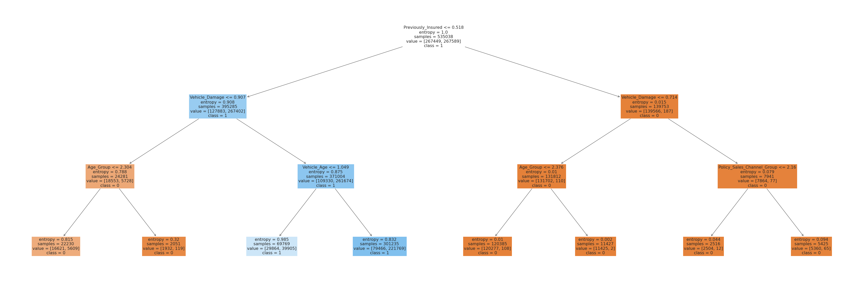
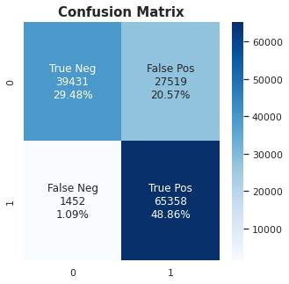
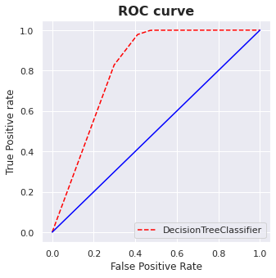
Decision Tree Classifier
Decision tree is a flowchart-like tree structure, where each internal node denotes a test on an attribute, each branch represents an outcome of the test, and each leaf node (terminal node) holds a class label.
Parameters | Score
Accuracy | 0.783710
Recall | 0.978865
Precision | 0.703832
F1 Score | 0.818872
ROC-AUC | 0.834631

Slide 21
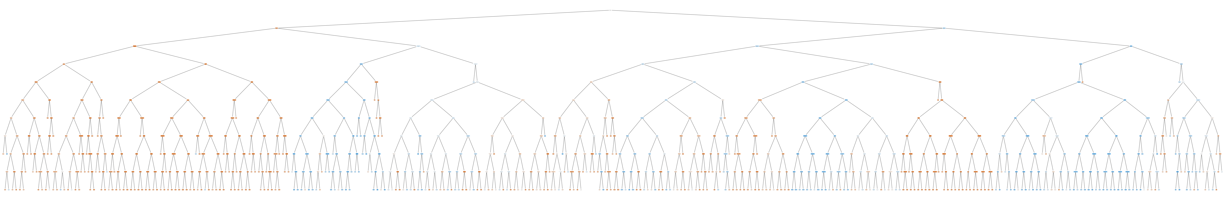
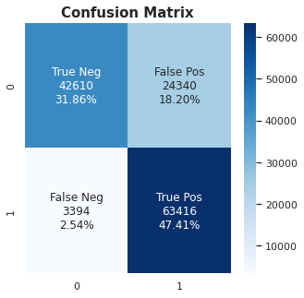
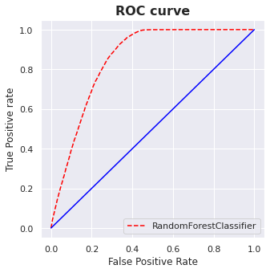
Random Forest Classifier
The random forest algorithm is made up of a collection of decision trees, and each tree in the ensemble is comprised of a data sample drawn from a training set with replacement, called the bootstrap sample.
Parameters | Score
Accuracy | 0.808388
Recall | 0.937150
Precision | 0.744997
F1 Score | 0.830098
ROC-AUC | 0.830270

Slide 22
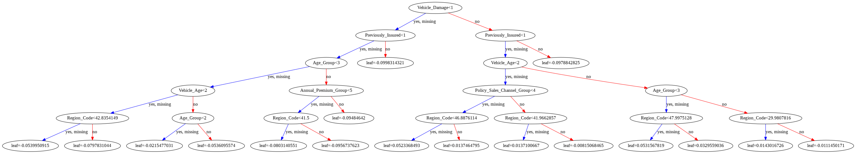

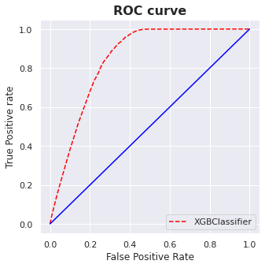
XGBoost Classifier
XGBoost, which stands for Extreme Gradient Boosting, is a decision-tree-based ensemble Machine Learning algorithm that uses a gradient boosting framework and provides parallel tree boosting.
Parameters | Score
Accuracy | 0.787418
Recall | 0.964287
Precision | 0.712080
F1 Score | 0.819211
ROC-AUC | 0.828480

Slide 23
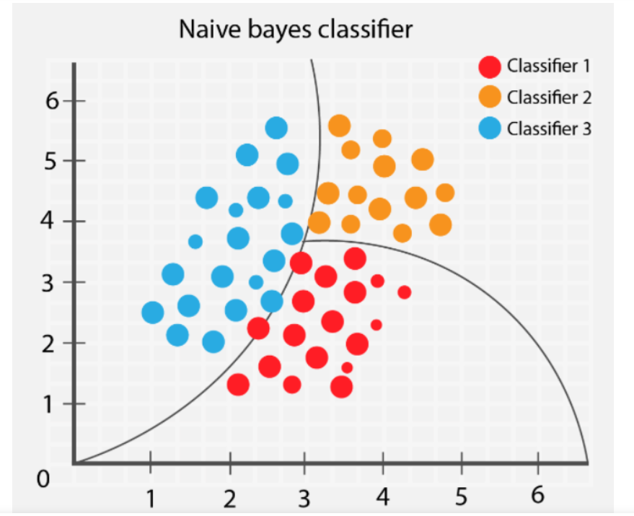

Naive Bayes Classifier
A Naive Bayes classifier is a probabilistic machine learning model based on Bayes' Theorem that is used for classification task.
Parameters | Score
Accuracy | 0.784046
Recall | 0.978087
Precision | 0.704402
F1 Score | 0.818985
ROC-AUC | 0.834344

Slide 24
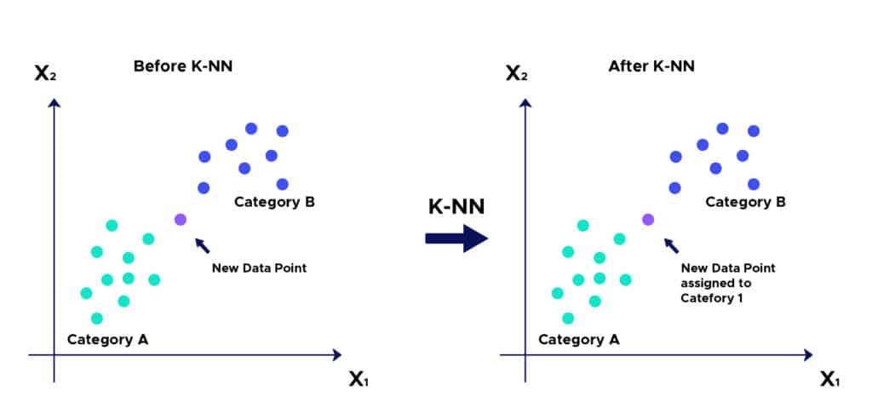

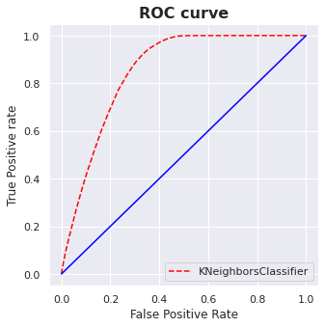
K-Nearest Neighbors(KNN)
The k-nearest neighbors algorithm, also known as KNN or k-NN, is a non-parametric, supervised learning classifier, which uses proximity to make classifications or predictions about the grouping of an individual data point.
Parameters | Score
Accuracy | 0.792644
Recall | 0.940248
Precision | 0.725699
F1 Score | 0.819159
ROC-AUC | 0.820560

Slide 25
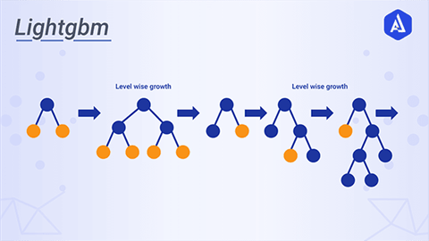
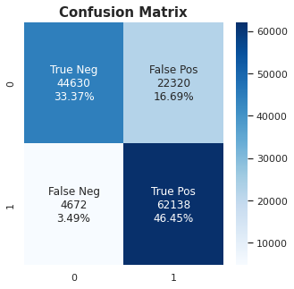

Light Gradient Boosting(LGBM)
LightGBM is a gradient boosting framework based on decision trees to increases the efficiency of the model and reduces memory usage.
Parameters | Score
Accuracy | 0.798034
Recall | 0.923050
Precision | 0.738171
F1 Score | 0.820323
ROC-AUC | 0.817898

Slide 26
Comparison Metrices
 | Accuracy | Recall | Precision | F1 Score | ROC-AUC
Random Forest | 0.808388 | 0.937150 | 0.744997 | 0.830098 | 0.830270
LightGBM | 0.798034 | 0.923050 | 0.738171 | 0.820323 | 0.817898
KNN | 0.792644 | 0.940248 | 0.725699 | 0.819159 | 0.820560
XGBoost | 0.787418 | 0.964287 | 0.712080 | 0.819211 | 0.828480
Naïve Bayes | 0.784046 | 0.978087 | 0.704402 | 0.818985 | 0.834344
Decision Tree | 0.783710 | 0.978865 | 0.703832 | 0.818872 | 0.834631
Random Forest Classifier Method is the model with highest accuracy

Slide 27


